Slide 1
complaints against police
Q8Which state has more number of complaints against police?
Query:-
SELECT * from "25_Complaints_against_police";
SELECT Area_Name,
sum(CPA_Complaints_Received_or_Alleged) as complaints from "25_Complaints_against_police"
GROUP by Area_Name
ORDER by complaints DESC;

Slide 2
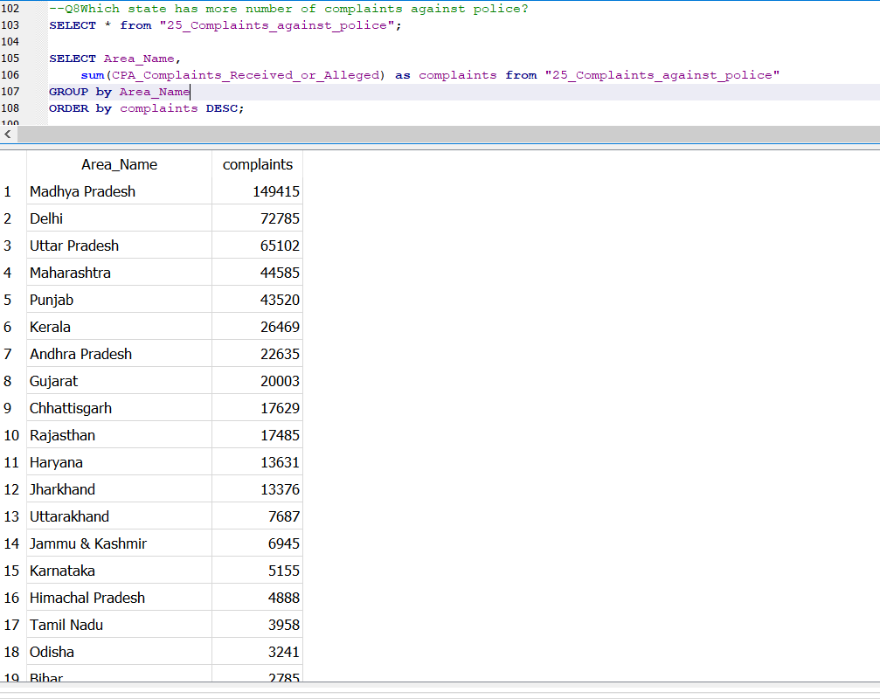
Our query screenshot:-

Slide 3
